Slide 1
EE 521/ECE 582 – Analysis of Power systems
Class #8 – September 20, 2022
Dr. Noel N. Schulz
Edmund O. Schweitzer III Chair in
Power Apparatus and Systems
Chief Scientist Joint Appointment, PNNL
Co-Director, PNNL/WSU Advanced Grid Institute (AGI)
Washington State University Pullman
Noel.Schulz@wsu.edu EME 35
509-335-0980 (o) and 509-336-5522 (c)

Slide 2
Student Hours
Office Hours This Week
Tuesdays 4:30-5:30 pm (after class) - Zoom
Wednesdays 4-5 pm Zoom or EME 35 Pullman
Fridays 1:30-2:30 pm Zoom or EME 35 Pullman
Join from PC, Mac, Linux, iOS, or Android: https://wsu.zoom.us/j/8237216735 (Links to an external site.)
Meeting ID: 823 721 6735
Or by request via email noel.Schulz@wsu.edu or phone 509-336-5522

Slide 3
Check In Meetings
Remaining ones – Wednesday and Friday
Checking your work – Example on Page 90 of textbook (3 bus) and example in notes (4 bus)
14 Bus Cases
Do not use Tap values for first part of work (will discuss next week)
Do a few Y bus calculations by hand and compare to your program (including Y99)
Will post information from check-in meetings in discussions on Canvas

Slide 4
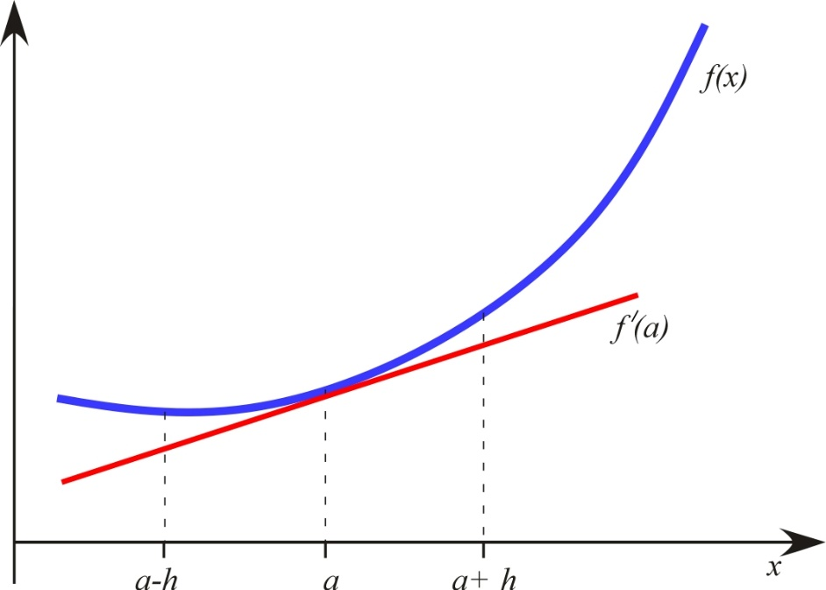
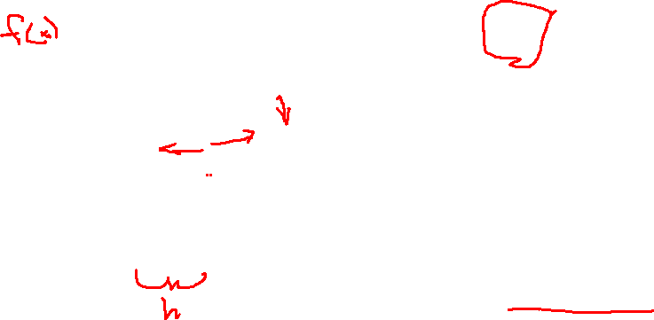
Numerical Differentiation
Another quasi-Newton approach is to approximate the individual entries of the Jacobian through numerical differentiation. Consider the slope of f(x) evaluated at a:
Let h be a small difference in x, then
is the backward difference approximation
is the forward difference approximation
is the center difference approximation

Slide 5

Even more complex methods of numerical differentiation are possible. The following is the Richardson approximation:
However the amount of computation required for the derivative approximation must be weighed against the increase in accuracy.
No Quasi-Newton method will exceed the full Newton-Raphson in convergence speed.

Slide 6

Newton-Krylov Methods
In the previous Quasi-Newton methods, it was assumed that linearized iterates were ultimately solved using a direct method. However, there is no reason why this should be. In fact, it is possible by combining a Newton-Raphson iteration (outer) with an iterative linear solver (inner), that computational gains may be achieved, especially for solvers such as the GMRES method.
Furthermore, the GMRES requires only the vector product of the Jacobian with a vector, which can be approximated using a difference method. This approach is called a Jacobian Free GMRES method.

Slide 7

Jacobian-Free Newton-GMRES Algorithm for Solving f(x) = 0

Slide 8

Use difference approximation

Slide 9
Example:
Solve
Let h = 10⁻³, ε = 10⁻³ , and

Slide 10
This is the vector product that replaces calculating the Jacobian
h
Difference approximation
h
h
h
We have this from above

Slide 11
Complete GMRES iteration
Since the error is larger than the convergence tolerance, the inner loop is repeated.

Slide 12
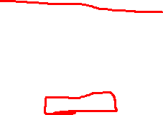
Inner loop has converged, therefore proceed

Slide 13
This is the first update of the outer loop
This outer error is too large, so the entire process (both inner and outer iterations) is repeated
After convergence
There errors are nearly identical to the original Newton-Raphson solution
The potential savings from using a Jacobian-Free Newton-GMRES method arise from not having to calculate the system Jacobian at every step. Furthermore, it is possible that the GMRES iteration may not require a full number of iterations (k < n) as x^{q} approaches convergence.

Slide 14
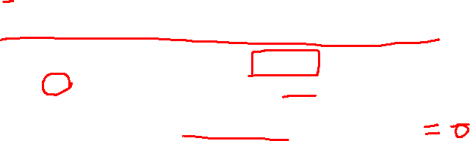
Continuation and Homotopy Methods
In many physical systems, the problem defined by the mathematical equation f(x) = 0 may in some way depend in a natural way on a parameter smoothly varying λ of the system.
λ may be a parameter such as temperature, load, or pressure
When λ is set equal to 0, the system f₀(x) = 0 has a known solution x₀. However, for varying λ, and entire family of functions H(x, λ) exist such that:
H(x,0) = f₀(x) and H(x,1) = f(x)
where a solution x₀ of H(x,0)=0 is known, and the equation H(x,1) = 0 is the desired problem to be solved.

Slide 15

In other words, the homotopy method slowly morphs the problem f₀(x)=0 into the problem f(x)=0 as λ goes from zero to one.
In most cases, f₀(x)=0 is a well-defined problem with an easy to compute solution.
The function f(x)=0 may be difficult to solve due to either difficult to estimate initial conditions, or perhaps a region in which the Jacobian is ill-conditioned.

Slide 16
Example: Morph the system of equations
into
Solution (2,3)
Solution (-3,2)

Slide 17
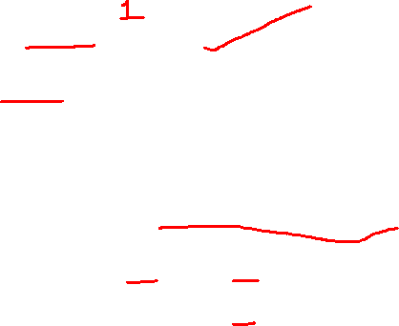
A Homotopic function:
At
The homotopic function is solved via a predictor/corrector step:
The predictor step takes the form:

Slide 18
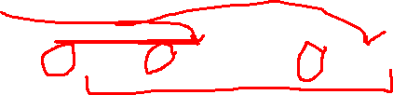
Predictor step at every step i:
NR Corrector step at every step i where x^{(k=0)} =x^{i}
Derivative/Jacobian of f(x) and f₀(x)

Slide 19
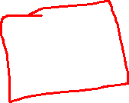
Example again: Solve the system of equations
using the homotopic mapping from

Slide 20
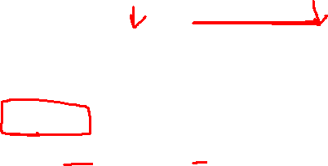
Define:
With

Slide 21
Then the prediction step:

Slide 22
Correcting using Newton-Raphson:
After the NR converges:
Then repeat for i = 2, 3, etc. until λ = 1.0
The results as λ are as shown next.

Slide 23
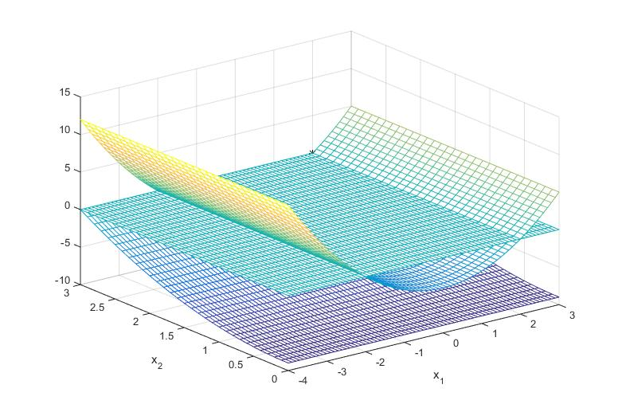
x₁, x₂ = (2,3), λ = 0
Set of equations at λ = 0

Slide 24
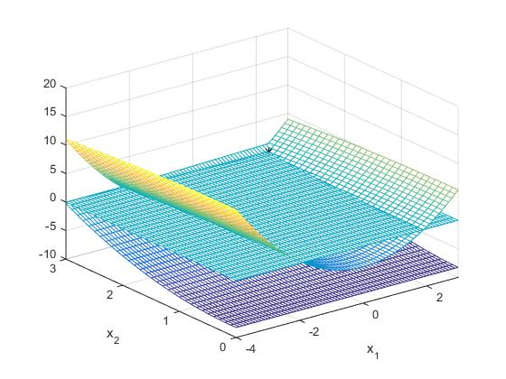
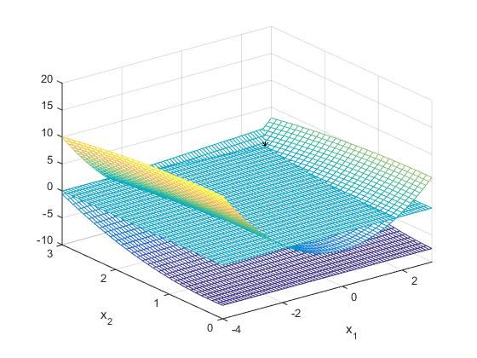
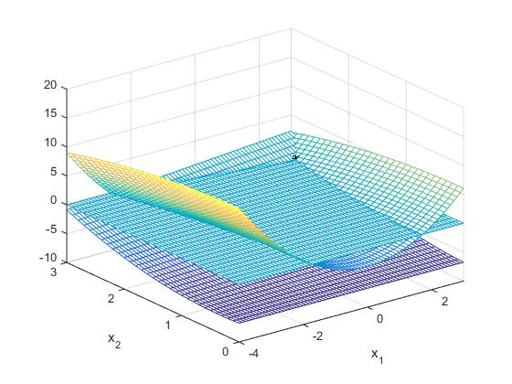
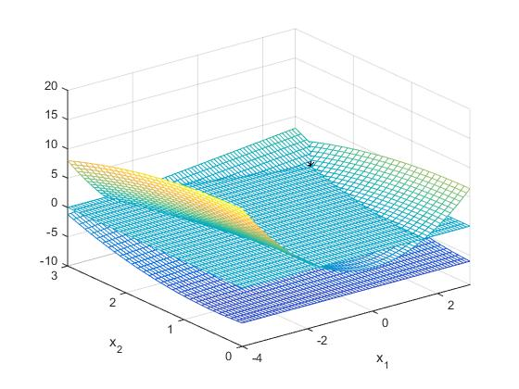

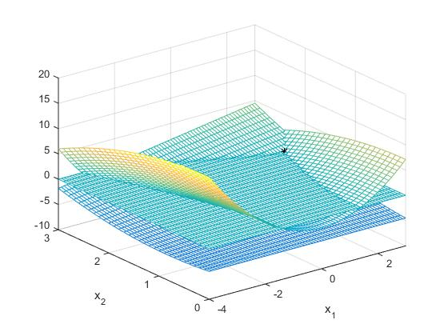
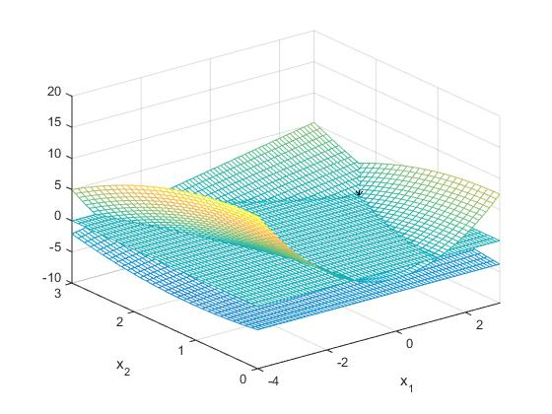
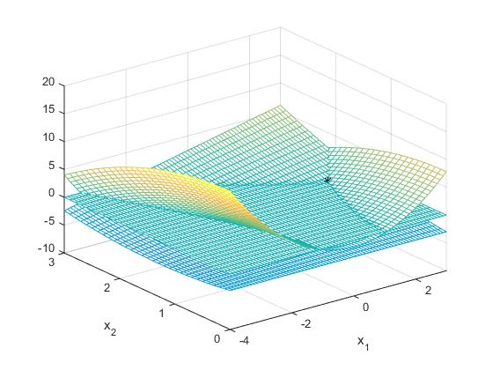
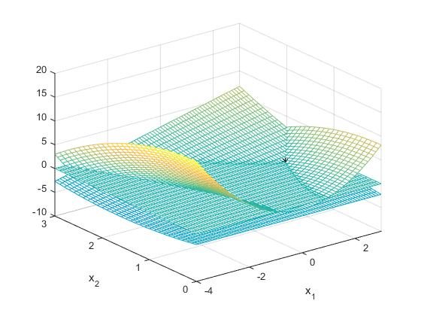
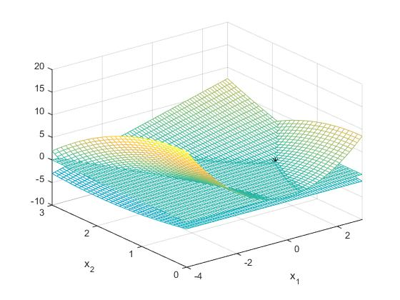
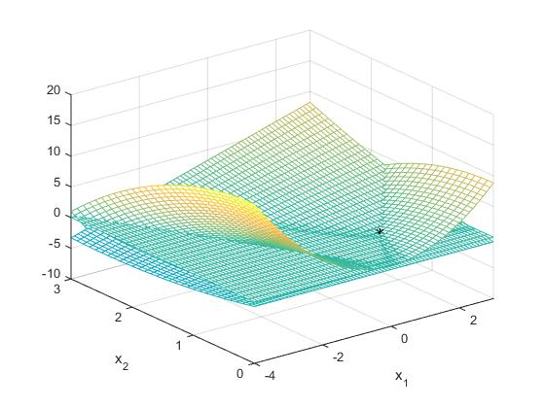
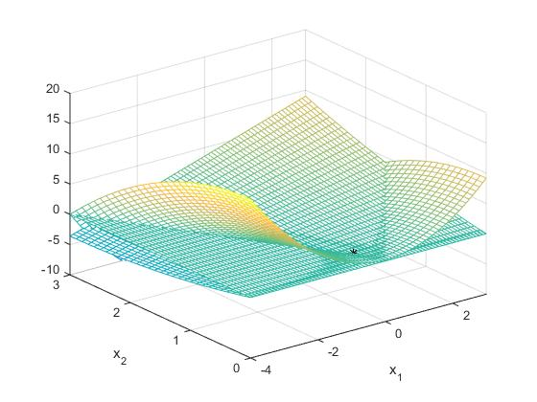
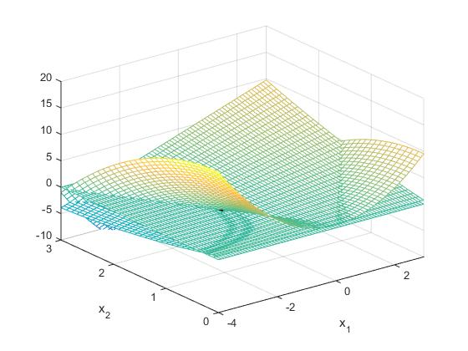

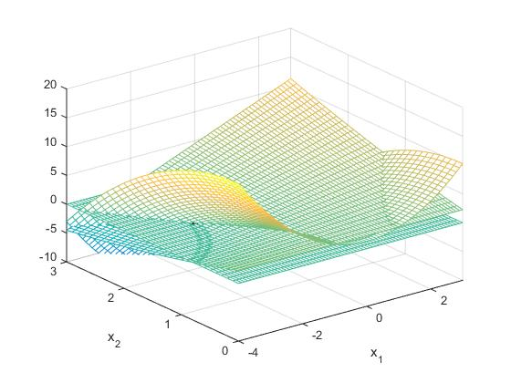
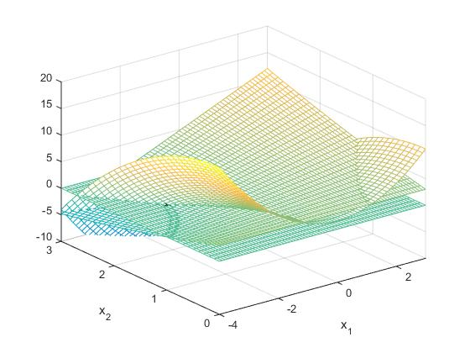

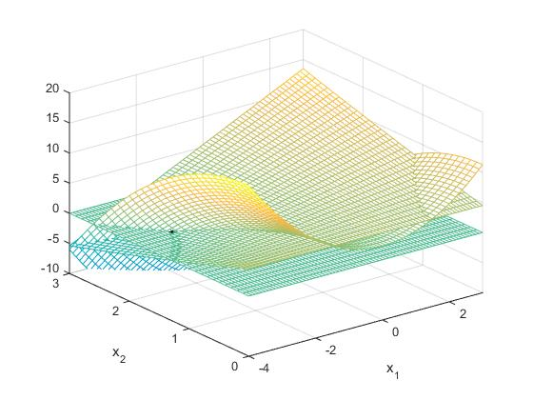
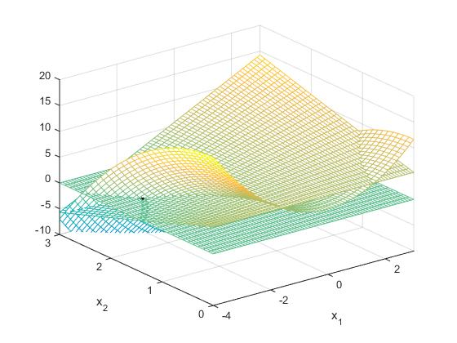
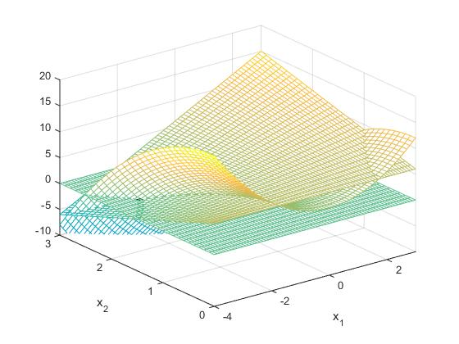
x₁, x₂ = (-3,2), λ = 1

Slide 25
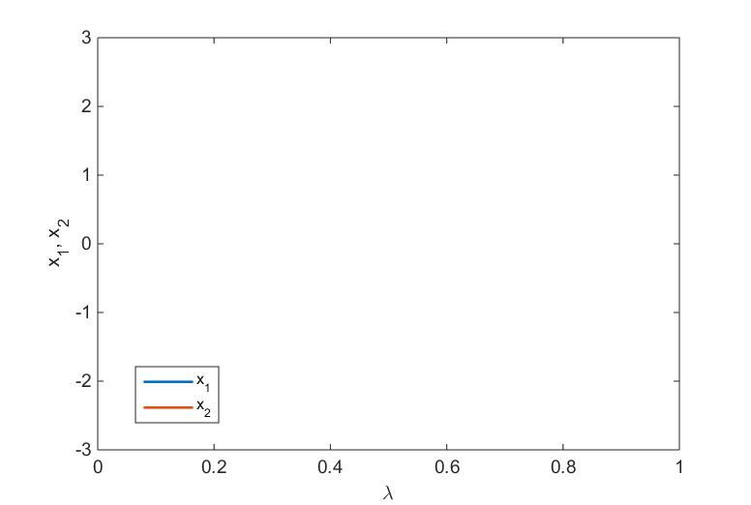
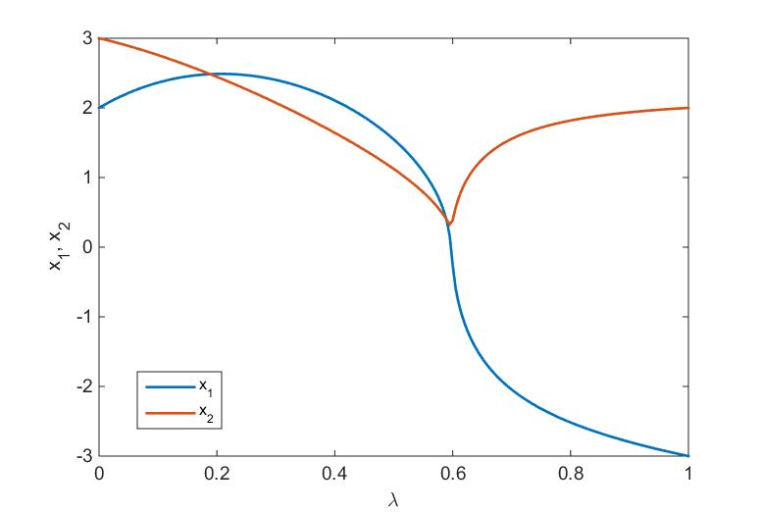
x₁, x₂ = (2,3)
x₁, x₂ = (-3,2)
Progression of x₁ and x₂ as λ goes from 0 to 1

Slide 26
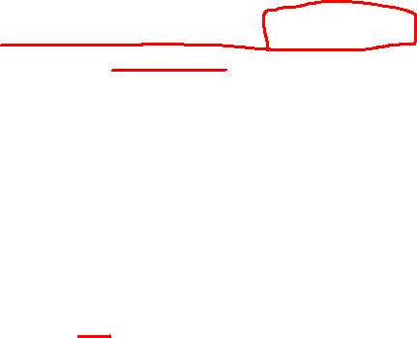
Homotopy is used when the original system may become ill-conditioned. The Jacobian of the merged systems remains non-singular even when the Jacobian of the original system becomes singular:
Newton-Raphson
May be singular
Homotopy
Non-singular

Slide 27
Power System Applications

Slide 28
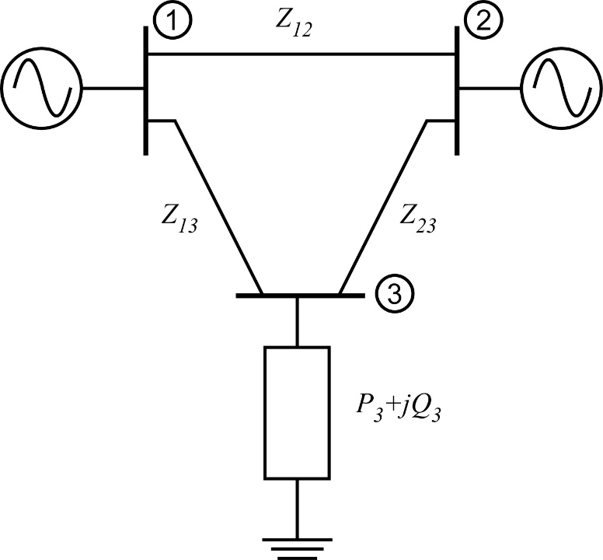
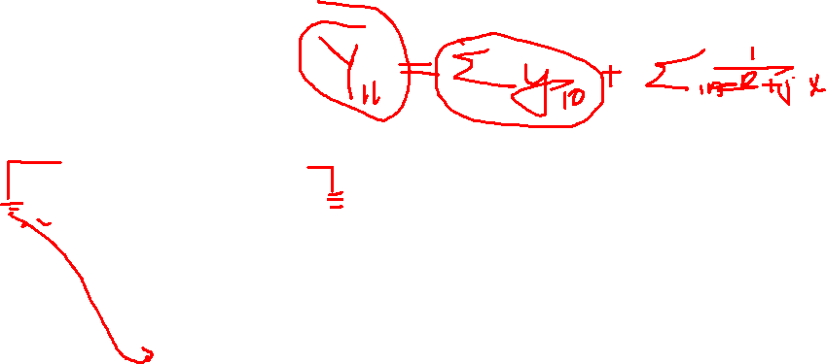
Find the voltage magnitudes, phase angles, and line flows for the small power system with the following system parameters in per unit:
Bus data
Bus | Type | V | P_{G} | Q_{G} | P_{L} | Q_{L}
1 | Slack | 1.02 | -- | -- | 0.0 | 0.0
2 | PV | 1.00 | 0.5 | -- | 0.0 | 0.0
3 | PQ | -- | 0.0 | 0.0 | 1.2 | 0.5
Independent
Unknowns:
Knowns:
Line data
Bus 3:
P_{3,inj} and Q_{3,inj}
V₃ and θ₃
i | j | R_{ij} | X_{ij} | B_{ij}
1 | 2 | 0.02 | 0.3 | 0.15
1 | 3 | 0.01 | 0.1 | 0.1
2 | 3 | 0.01 | 0.1 | 0.1
Bus 2:
P_{2,inj} and V₂
θ₂
Bus 1:
V₁ and θ₁
none

Slide 29
Find admittance matrix Y:
Line data
i | j | R_{ij} | X_{ij} | B_{ij}
1 | 2 | 0.02 | 0.3 | 0.15
1 | 3 | 0.01 | 0.1 | 0.1
2 | 3 | 0.01 | 0.1 | 0.1
This is capacitive line charging: put ½ of B_{ij} at each node i and j

Slide 30

Jacobian:
Error= = 1.1802
In radians, not degrees!

Slide 31
Repeat for iteration 2 – update Jacobian and mismatch:
Error= = 0.0359

Slide 32
Repeat for iteration 3 – update Jacobian and mismatch:
Error= = 0.0009084
Converged!

Slide 33
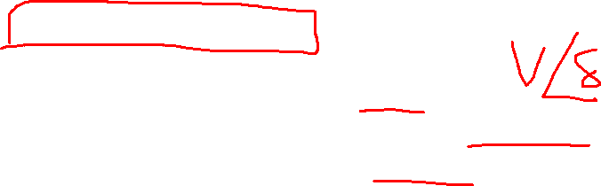
Calculate Dependent Unknowns:
Slack bus powers

Slide 34
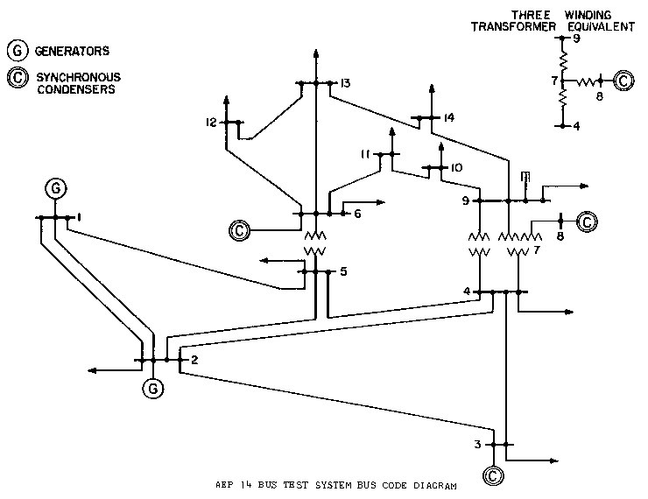
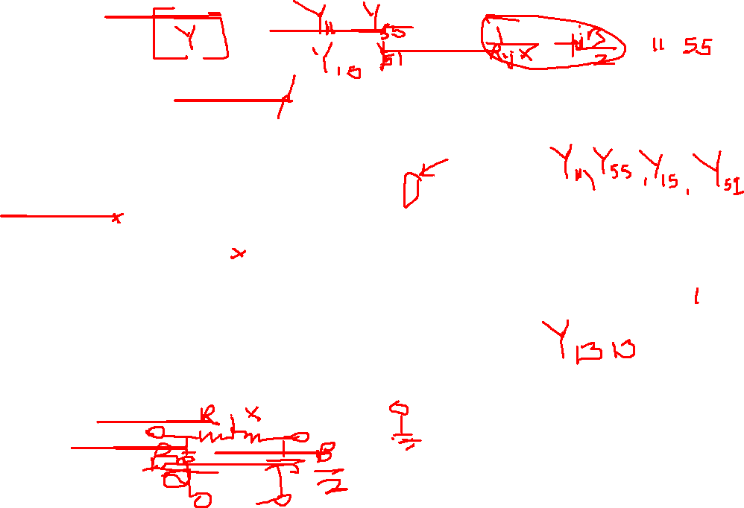
What Y terms are affected if Line between 1 and 5 is opened?
What Y terms are affected if I add a capacitor bank to Bus 3

Slide 35
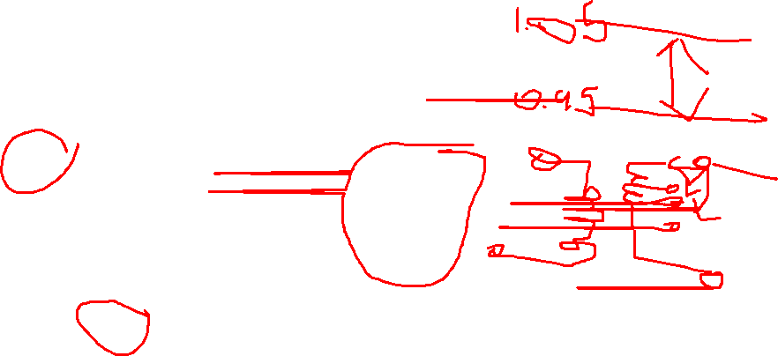

Slide 36
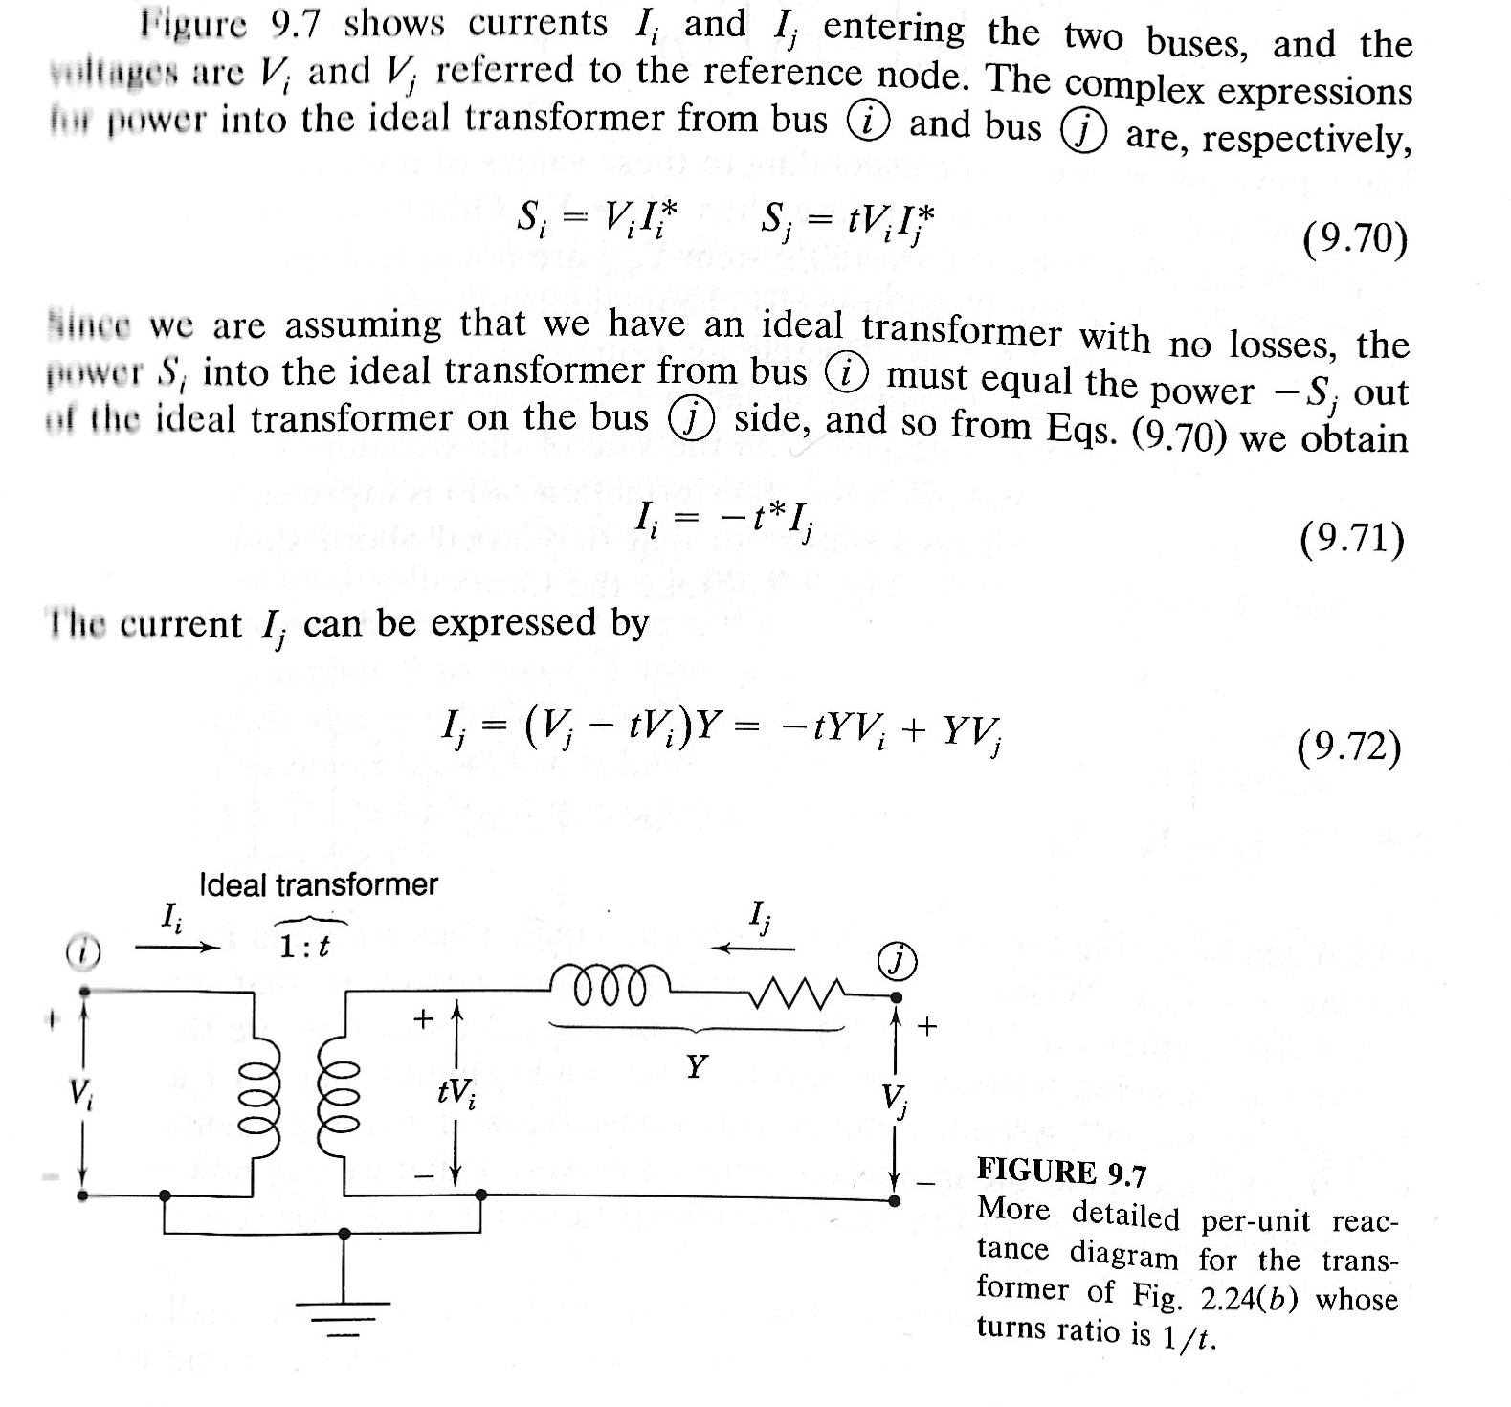

Slide 37
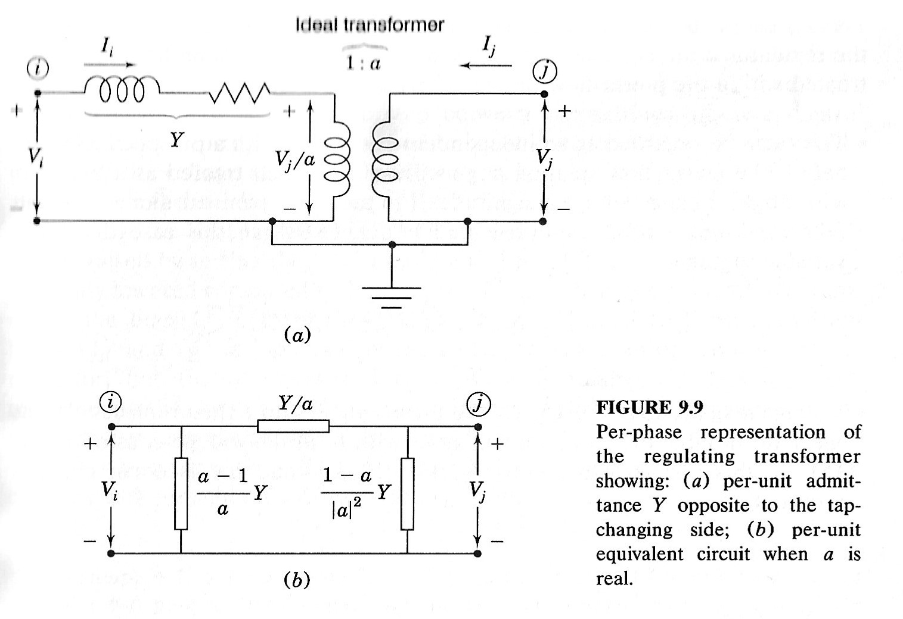
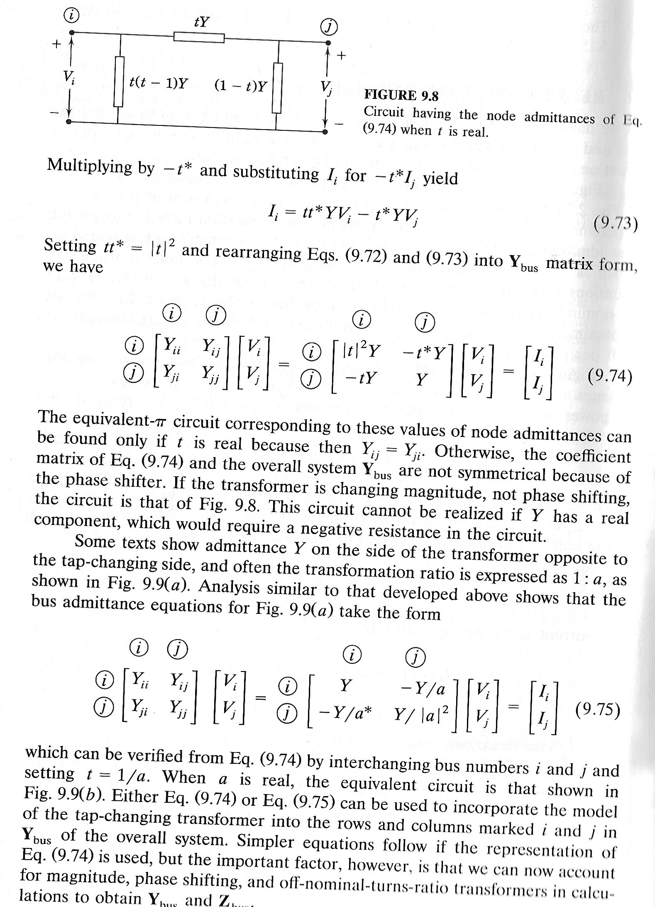


Slide 38
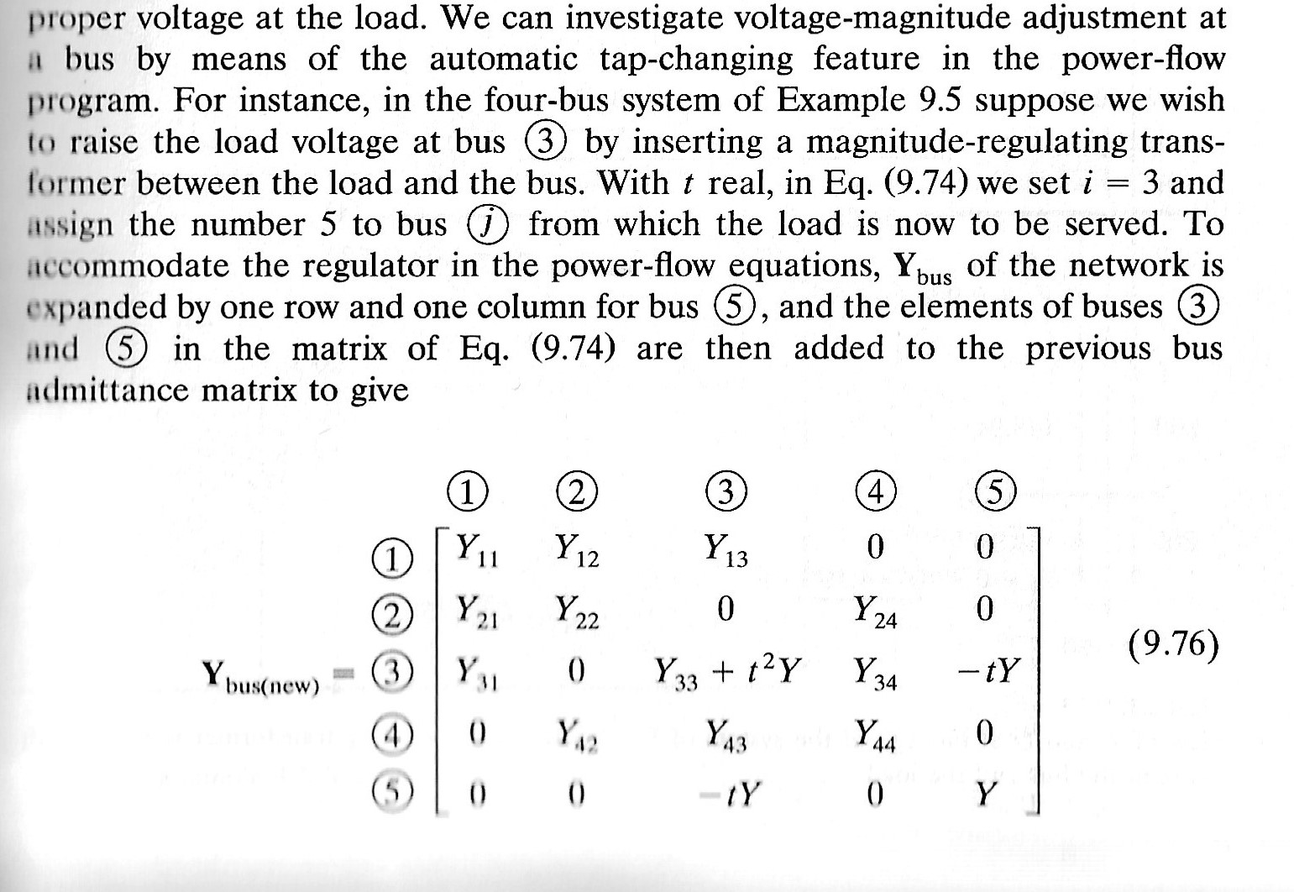


Slide 39
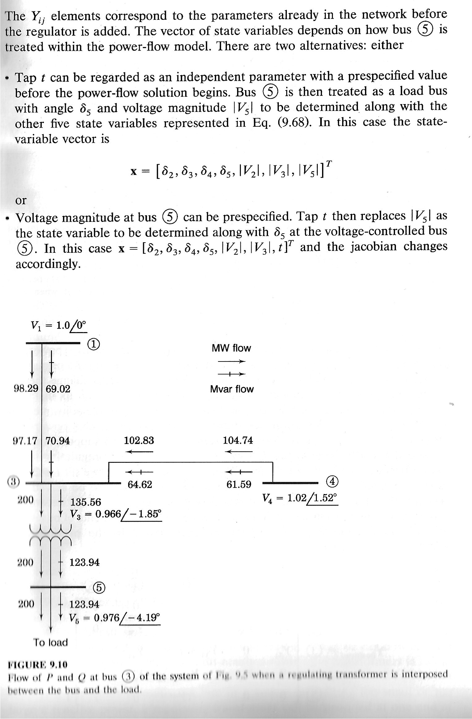
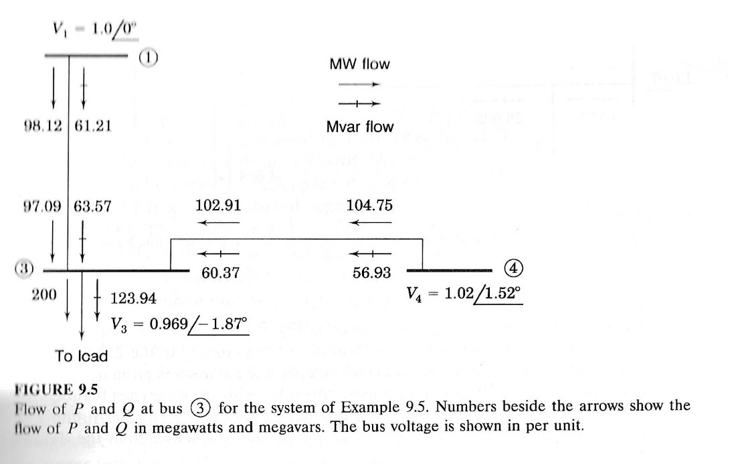
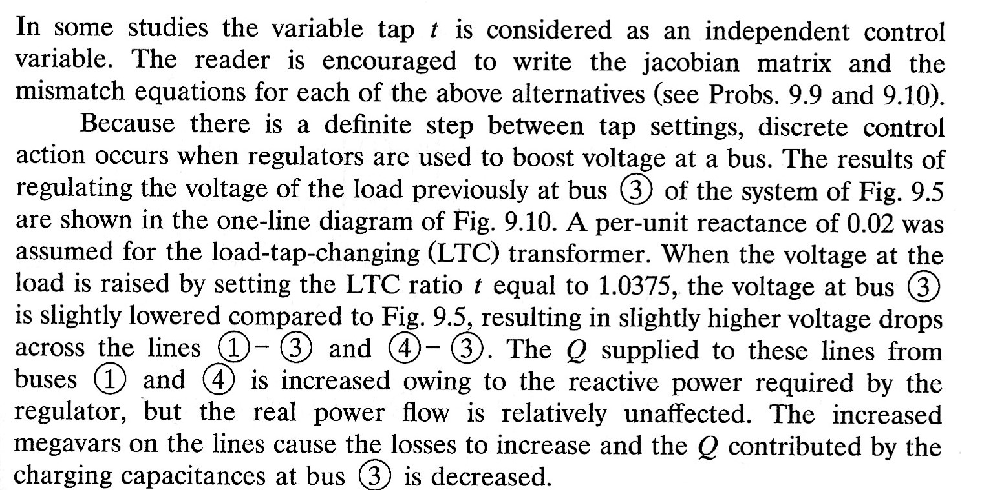
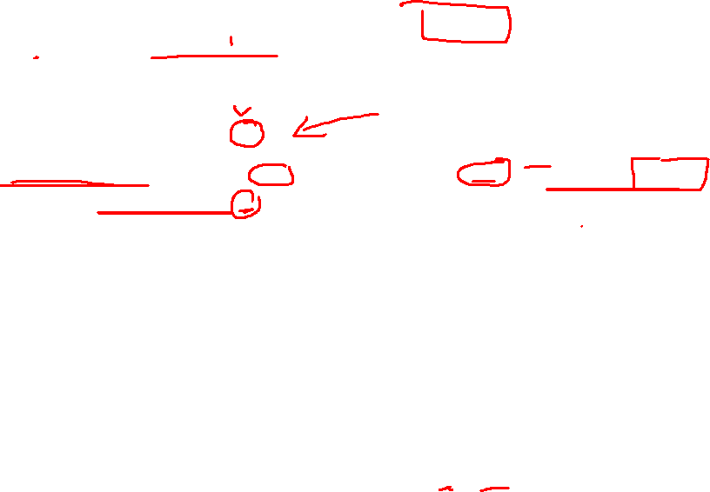

Slide 40
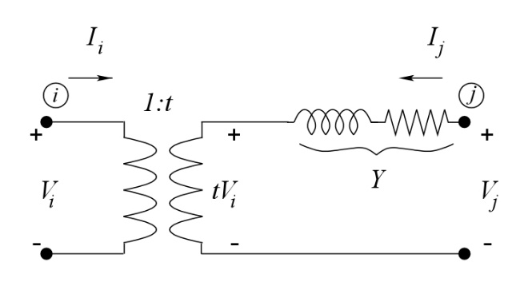
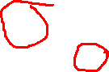
Regulating Transformers in Power Flow
Put in admittance matrix form:
Y(i,j)
add to Y(i,i)
Y(j,j) no change
Y(j,i)

Slide 41

If the voltage at bus j is regulated, the voltage magnitude V_{j} becomes a known value and the tap setting t is now the unknown.
Another approach is to let directly solve for t from the Newton-Raphson. All partial derivatives with respect to V_{j} are replaced with derivatives with respect to t
Pros and Cons for each approach?

Slide 42
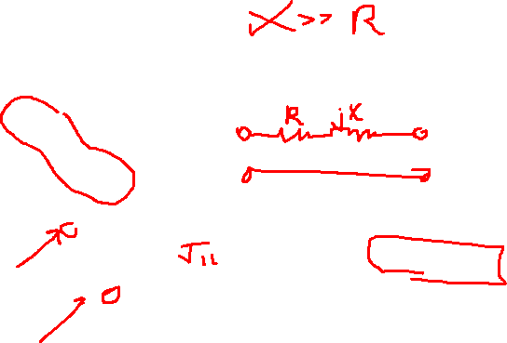
Decoupled Power Flow
Recall that the Jacobian does not need to be exact for the NR to still converge rapidly.
Consider the power flow Jacobian:
If the transmission lines are primarily reactive, then ϕ_{ij} is ≈ 90º. Furthermore, adjacent bus angles are usually within a few degrees,
The generic form of is
The generic form of is
Therefore and

Slide 43
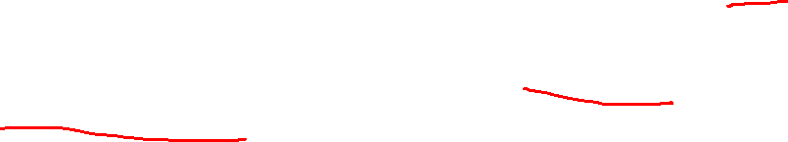
Therefore
Advantages:
Matrices are smaller, therefore decreasing LU factorization effort
V and θ iterations are performed separately and may converge independently (i.e. different number of iterations)
Disadvantages:
Convergence may be slow if system is not well-conditioned (i.e. zero assumption is not valid)
Many commercial programs have the option to switch between full and decoupled NR iterations.

Slide 44
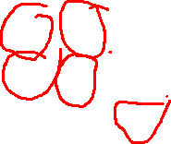
Revisit previous example:
Is smaller than this
This
This
Is smaller than this
Separate solutions:
Very close to full NR!
Continue until convergence…

Slide 45
Fast Decoupled Power Flow
In the previous decoupled power flow, the Jacobian was updated at every iteration. If the Jacobian is held constant at every iteration, the method is known as the “Very Dishonest Newton’s Method.” This method still requires at least one Jacobian evaluation.
However, another approach in which the Jacobian is a constant matrix is called the fast decoupled power flow. In this case, the Jacobian is approximated based on the line parameters.
Variations include the XB, BX, XX, and BB methods.
The XB and BX are the most common.

Slide 46
XB version:
Approximation to
Approximation to
where and is the shunt susceptance at bus i

Slide 47
Revisit previous example again:
→
Line data
i | j | R_{ij} | X_{ij} | B_{ij}
1 | 2 | 0.02 | 0.3 | 0.15
1 | 3 | 0.01 | 0.1 | 0.1
2 | 3 | 0.01 | 0.1 | 0.1

Slide 48
Compare sub-Jacobians:
Fast Decoupled
Sub-Jacobian at Flat Start
Iterate:
Very close to full NR!
Continue until convergence…

Slide 49
Programming Projects:
Power Flow Project (20%)
Y_{bus}, Jacobian matrices – Newton Raphson
LU Factorization, Backward-Forward substitution for NR
Fast Decoupled
Q-limits, transformer taps

Slide 50
Announcements
Finish Reading Chapter 3
Extra Video will drop Friday
MATLAB Program
Input the CDF file – Start with Data in Program
Start working on building the Ybus
Calculate Jacobian Matrix Values
Work on LU Decomposition and Solution
Next Add Tap Changing feature
Start working on Fast Decoupled
See example on Page 90 to check your work

